Slide 1

ABSTRACT FACTORY PATTERN
CREATIONAL PATTERN

Slide 2

Factory is an ambiguous term that stands for a function, method or class that supposed to be producing something. Most commonly, factories produce objects. But they may also produce files, records in databases, etc.
Definition

Slide 3

Abstract Factory
The Abstract Factory is a creational design pattern that allows producing families of related or dependent objects without specifying their concrete classes.

Slide 4
Abstract Factory
to provide an interface for creating families of related objects, without specifying concrete classes.

Slide 5
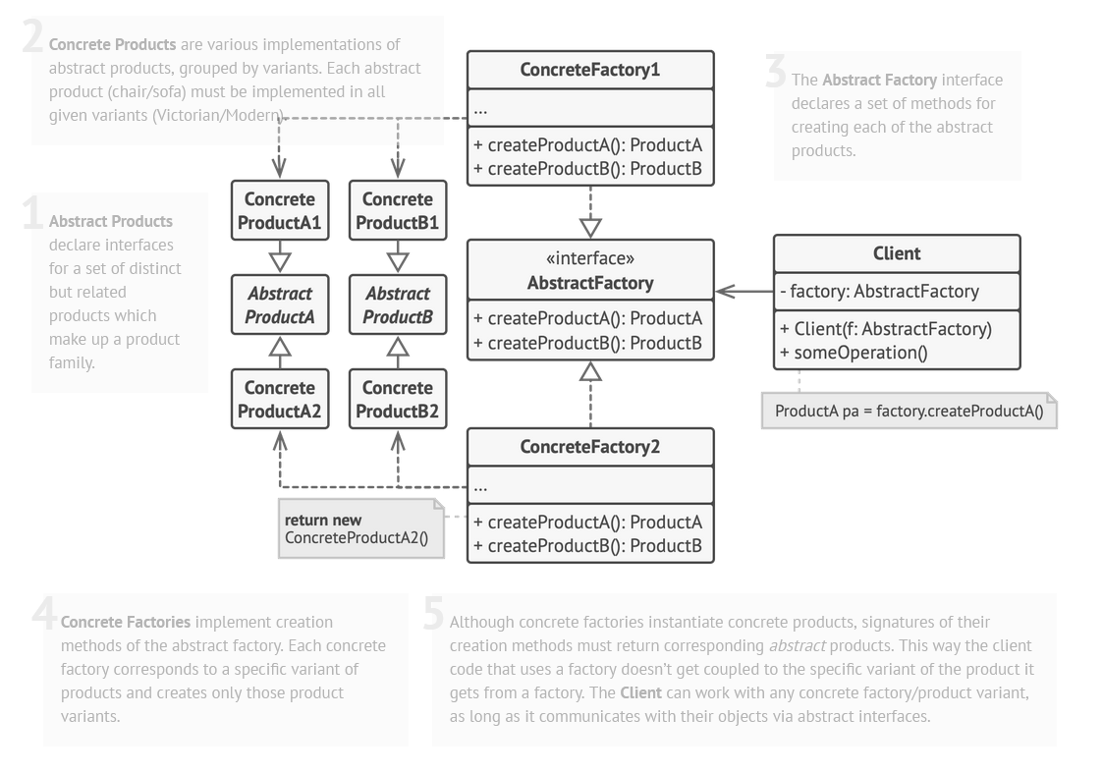

Slide 6
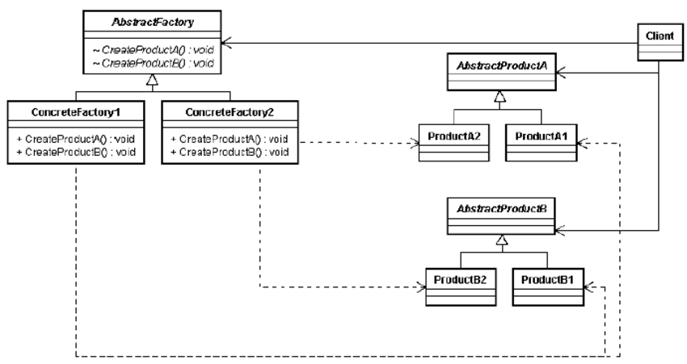

Slide 7
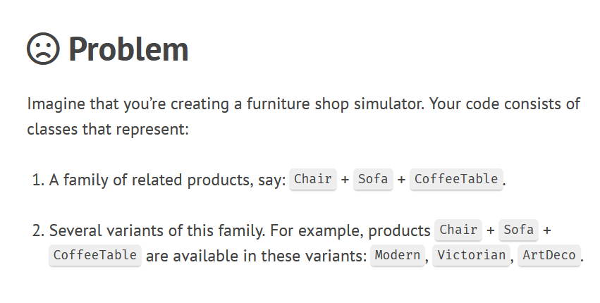

Our Agency Locations
PROBLEM

Slide 8
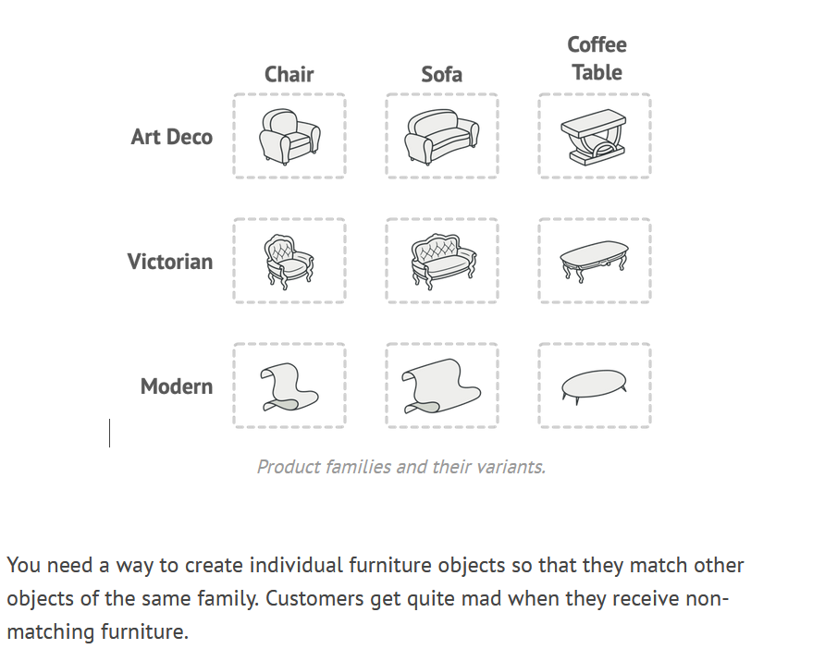

Slide 9
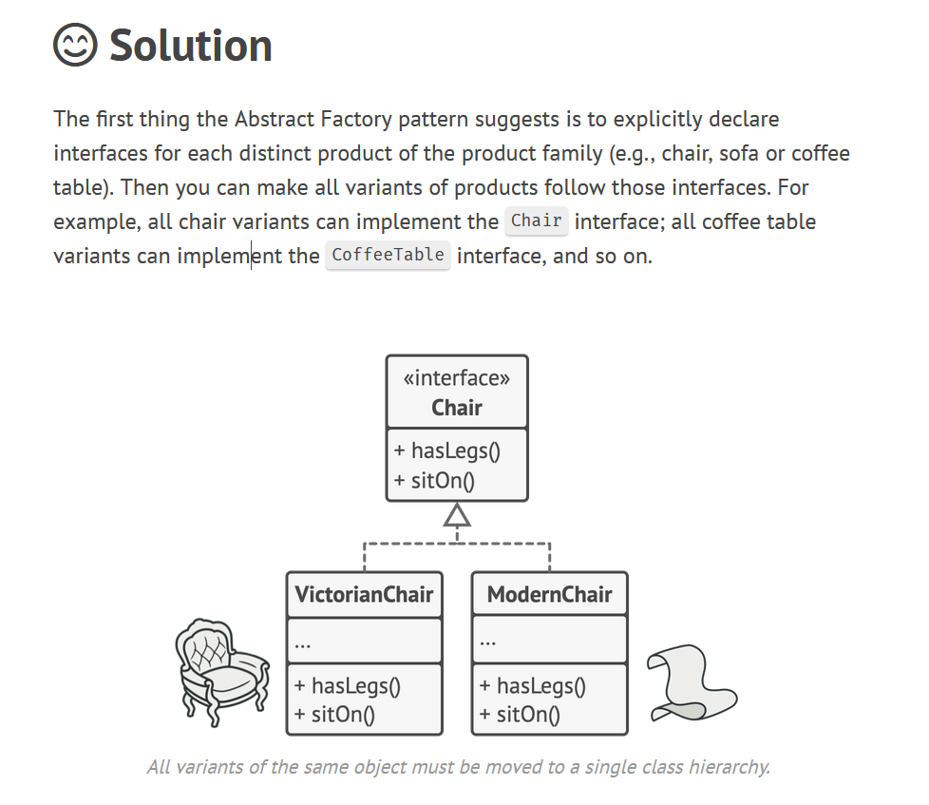

Slide 10
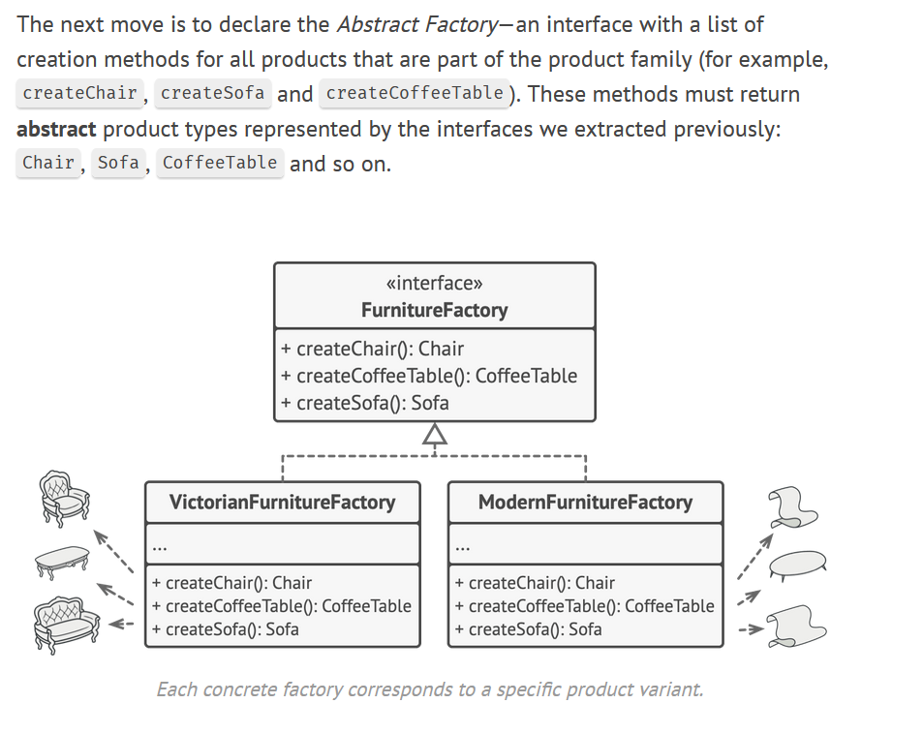

Slide 11


THE CODE DEMO
IS UP NEXT

